Slide 1
Unit-3, Module-I React JS

Slide 2

Introduction to React JS
ReactJS, a JavaScript library for creating user interfaces, makes the development of UI components easy and modular.
React JS was created by Jordan Walke, a software engineer at Facebook and open sourced to the world by Facebook and Instagram.
It focuses only on the view layer of an application (the UI).
Official tagline: “A JavaScript library for building user interfaces.”

Slide 3
Why did Facebook build React?
Back in 2011, Facebook had huge problems:
Their UI was becoming too complex.
Every time a user liked a post, wrote a comment, or received a notification → the entire page had to reload.
Facebook engineers wanted a faster way to update only what changed without reloading everything → React was born.
Break the UI into components (small reusable pieces).
Use a Virtual DOM to efficiently update only the changed parts.
Make apps faster, scalable, and easier to maintain.

Slide 4
Popularity & Usage
React is one of the most popular front-end frameworks / libraries.
Used by companies like Meta (Facebook, Instagram, WhatsApp Web), Netflix, Airbnb, Uber, Flipkart, Swiggy.
Huge community support, thousands of free packages.

Slide 5
Benefits of Learning React
Industry Demand → React developers are highly in demand.
Reusable Components → build once, use everywhere.
Cross-platform → not just websites:
React Native → mobile apps (Android/iOS).
Next.js → server-side rendering + full-stack apps.
Strong Ecosystem → Router, State management (Redux, Context API), UI libraries, etc.

Slide 6


Why React JS?
Let's have a look at the below post on Facebook

Slide 7
Why React JS?
The Facebook application has to do the changes by updating DOM tree of the page and re-rendering the page in browser.
Considering the application size of Facebook which has more than 1.6 billion daily users and 500,000 “likes” every minutes, this was a challenge to the engineers of Facebook.
React JS library which optimizes DOM manipulation by writing very simple code.

Slide 8
Why React JS?
In plain JS:
DOM manipulation is manual → document.getElementById() everywhere.
Updating UI requires selecting nodes & rewriting HTML.
In jQuery:
Easier than plain JS but still directly manipulates DOM → leads to slow performance in big apps.
Not scalable for large, dynamic applications.

Slide 9
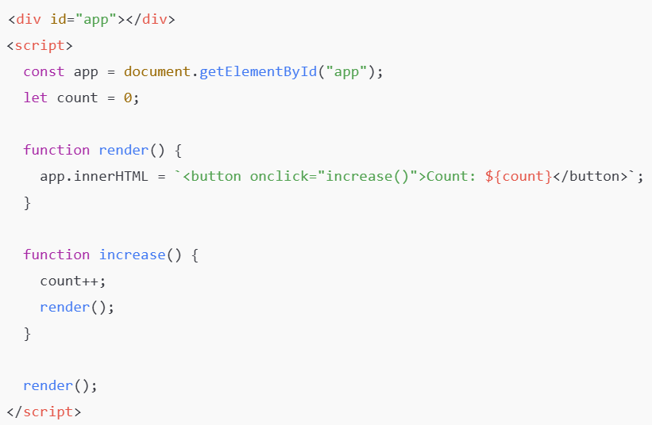
Why React JS?
Every update re-writes entire DOM → inefficient.

Slide 10
Single Page Application (SPA) Concept
Traditional websites → every click reloads full page.
SPA → loads once, then dynamically updates content using JS.
React helps in building SPAs easily.
Example:
Normal site: Home → About → reloads whole HTML.
SPA: Only content changes; header/footer stay same.

Slide 11
Features of React
Component-based → Build small reusable parts (button, navbar, form).
Virtual DOM → Fast updates without touching actual DOM much.
Reusable UI → Same component used multiple times.
Fast UI updates → Only changes are updated, not whole page.
JSX → Write HTML-like code inside JavaScript for clear component structure.
One-Way Data Binding → Data flows in one direction → easier to debug.
Declarative Style → Describe what UI looks like, not how to build it.
Community & Ecosystem → Huge support, libraries, and resources.

Slide 12
React Installation
To install create-react-app, follow the below steps:
Install node.js with version v20.X.X from Node.js official site or from Software House.
Download from https://nodejs.org
Check versions:
node -v
npm -v
Create React App : Install create-react-app by running the of following command (3 methods)
> npm install -g create-react-app
Once the installation is done, create a React app using the below command:
>create-react-app my-app

Slide 13
Another Methods
2nd Method
If you do not want to install create-react-app then you can use the below command to create a React application.
>npx create-react-app my-app
Next go to the project folder and Run the application
cd myapp
npm start
3rd Method
Vite Setup (faster alternative)
> npm create vite@latest myapp
> cd myapp
> npm install
> npm run dev

Slide 14
npx VS Vite Setup
Feature | npx create-react-app | Vite Setup
Command | npx create-react-app myapp | npm create vite@latest myapp
Bundler | Webpack (older) | Vite (ESBuild + Rollup)
Dev Server Port | http://localhost:3000 | http://localhost:5173
Speed | Slower (heavier) | Much faster (modern)
Project Size | Larger | Smaller
Recommendation | Legacy, less preferred | Recommended by React team

Slide 15
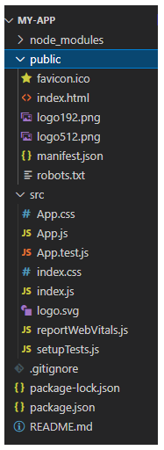
Folder Structure Overview
Key folders/files (after setup):
Files | Purpose
node_modules | All the node module dependencies are created in this folder.
public | This folder contains the public static assets of the application.
public/index.html | This is the first page that gets loaded when you run the application.
src | All application related files/folders are created in this folder.
src/index.js | This is the entry point of the application.
package.json | Contains the dependencies of the React application.

Slide 16
React System Configuration - Internal
Observe the file src/index.js :
ReactDOM.render(<h1>HelloReact!</h1>, document.getElementById('root'));
ReactDOM.render is used to render an element or component to the virtual DOM.
The first argument specifies what needs to be rendered.
The second argument specifies where to render.
The root element is present inside index.html:
<body>
<noscript>You need to enable JavaScript to run this app.</noscript>
<div id="root"></div>
</body>

Slide 17
DOM [Document Object Model]
It is a structured representation of the HTML elements that are present in a webpage or web-app.
DOM represents the entire UI of your application.
The DOM is represented as a tree data structure.
Simple getElementById() method
document.getElementById('some-id').innerValue = 'updated value';

Slide 18
DOM [Document Object Model]
When writing the above code in the console or in the JavaScript file:
The browser parses the HTML to find the node with this id.
It removes the child element of this specific element.
Updates the element(DOM) with the ‘updated value’.
Recalculates the CSS for the parent and child nodes.
Update the layout.
Finally, traverse the tree and paint it on the screen(browser) display.

Slide 19
Virtual DOM (VDOM)
A lightweight copy of the real DOM (stored in memory).
React uses it to compare changes (diffing).
Instead of updating the whole DOM, React only updates the changed parts.
Makes apps fast and efficient.

Slide 20
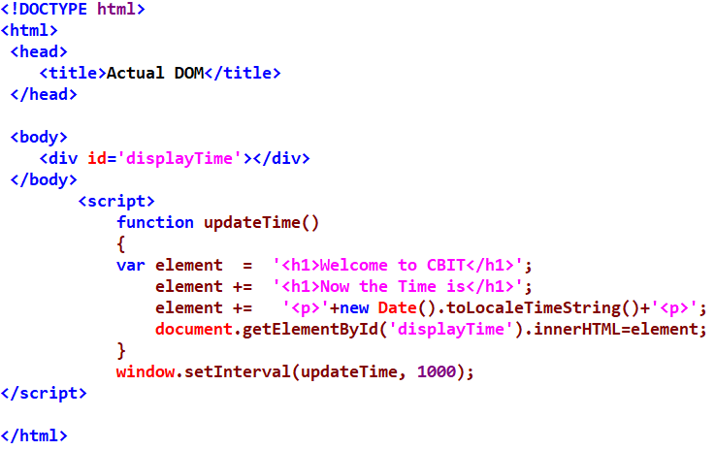
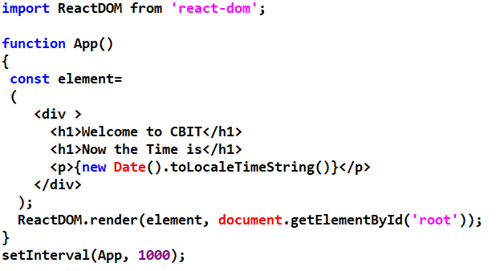
Actual DOM VS React VDOM

Slide 21
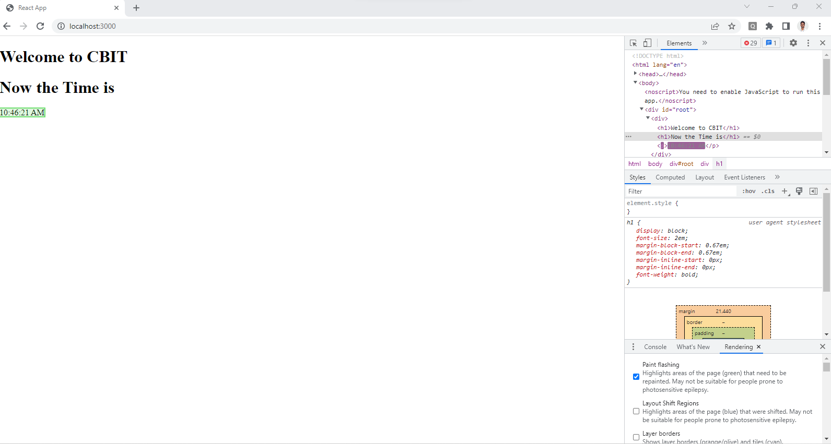
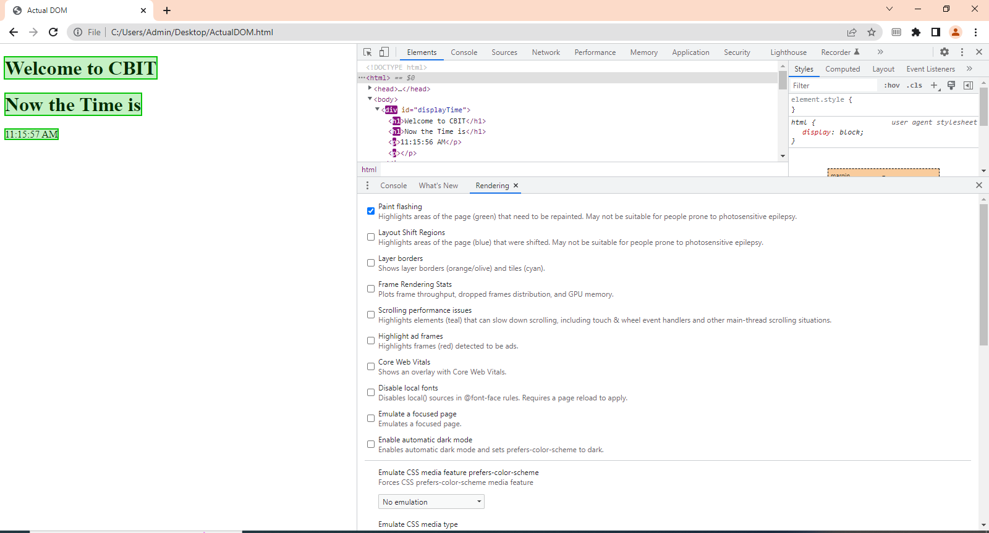
Actual DOM VS React VDOM

Slide 22
DOM VS VDOM
Feature | DOM (Actual DOM) | VDOM (Virtual DOM in React)
Definition | Browser’s tree representation of HTML | In-memory lightweight copy of DOM
Update Method | Updates entire tree/node | Updates only what changed (diffing)
Speed | Slower for large apps | Much faster and efficient
Memory Usage | Heavy | Lightweight
Example Change | Rewrite <div> content fully | Change only text node inside <div>

Slide 23
What is JSX? Why do we need it?
JSX (JavaScript XML) → A syntax extension that lets us write HTML-like code inside JavaScript.
Without JSX, UI must be written using React.createElement() → verbose and hard to read.
JSX makes components more readable and intuitive.

Slide 24
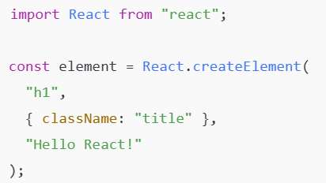
Example
(without JSX):
(with JSX):
Both produce the same output, but JSX is much simpler

Slide 25
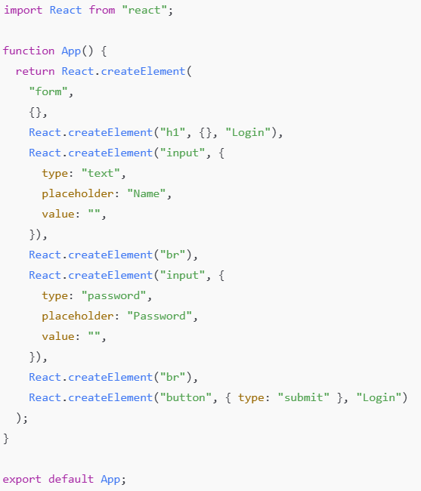
Example (JS Code)

Slide 26
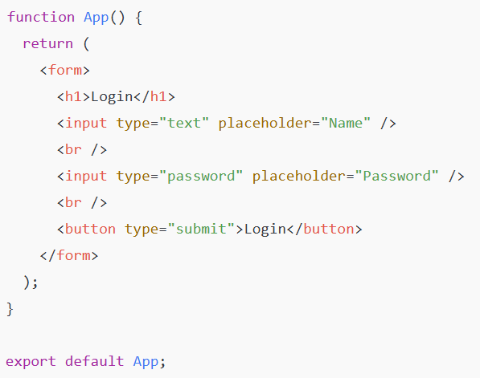
Example (Equivalent JSX code)

Slide 27
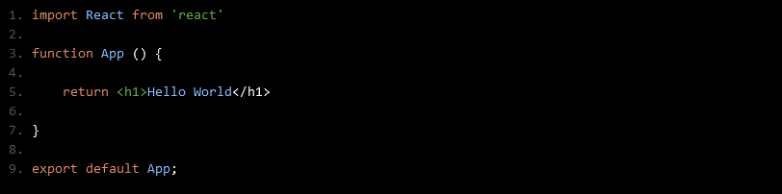
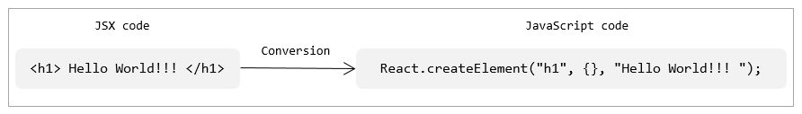
Why JSX in React JS ?
JSX is a special syntax introduced in ReactJS to write elements of components.
It is syntactically identical to HTML and hence it can be easily read and written
As the browser does not understand JSX code, this gets converted to JavaScript using the plugins of the babel

Slide 28
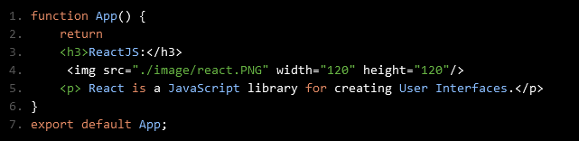
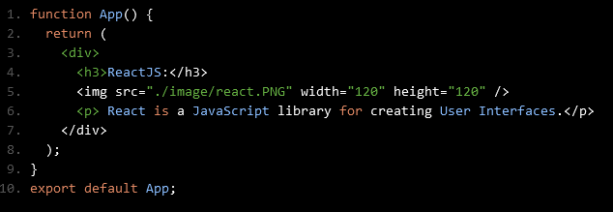
Why JSX in React JS ?
When working with React components, you may need to render multiple React elements
As per the JSX syntax, all the adjacent elements must be wrapped in an enclosing tag

Slide 29
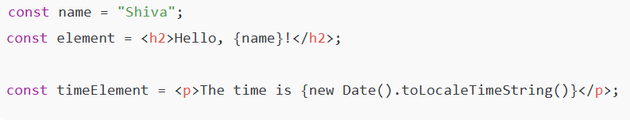
Embedding Expressions in JSX
We can insert JavaScript expressions inside { }.
Examples: variables, function calls, calculations, etc.
Example:

Slide 30
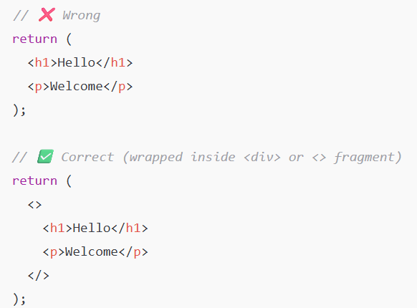
JSX Rules
Single Parent Element
JSX must return one root element.

Slide 31
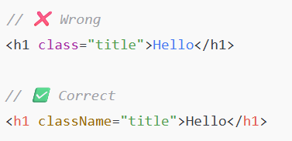
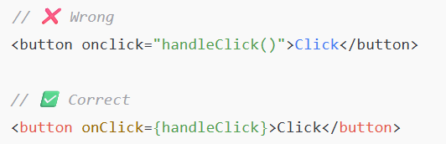
JSX Rules
className instead of class
camelCase Events

Slide 32
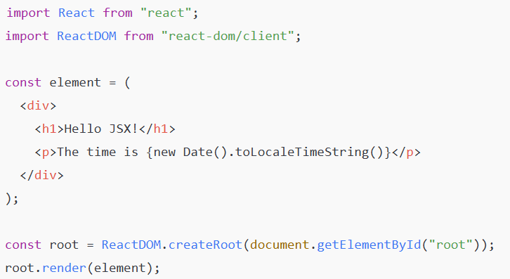
Rendering JSX with ReactDOM.createRoot().render()
In React 18, we use createRoot() instead of ReactDOM.render().

Slide 33
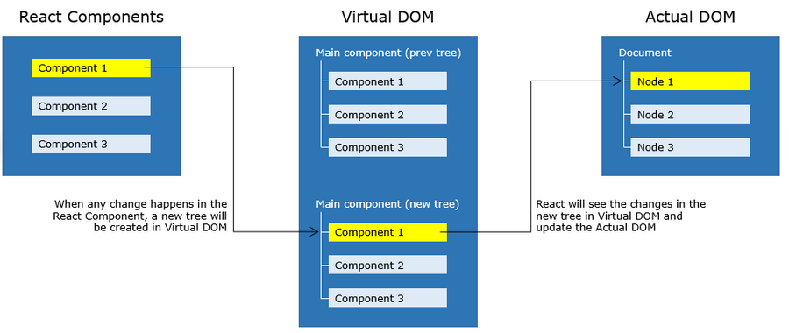
What is React Component?

Slide 34
React Component
Components are independent and reusable bits of code.
It’s just a JavaScript function (or class) that returns JSX.
Each component can have:
Its own structure (JSX → HTML-like code)
Its own style (CSS)
Its own behavior (state, events)
Why Components?
Reusability → Write once, use anywhere.
Maintainability → Each component handles one task → easier to debug.
Scalability → Big apps broken into small parts.

Slide 35
Types of Components
Functional Components
Class Components
These Components created as a simple JavaScript function
It just returns the HTML elements

Slide 36
React Component
App - The component name should be in Pascal Casing.
React.createElement - helps to create an element in plain JavaScript.
In the code, React.createElement("h1", {}, "Hello World!!!");
h1 - is the HTML element to be used
{ } - means attributes/props object of an element can be mentioned
"Hello World!!!" - Content to be appended to the h1 element
export default App - App component must be exported to use.

Slide 37

React Component
In JSX
React.createElement helps create an element → we don’t usually write it manually, JSX handles this.
export default App - App component must be exported to use.

Slide 38
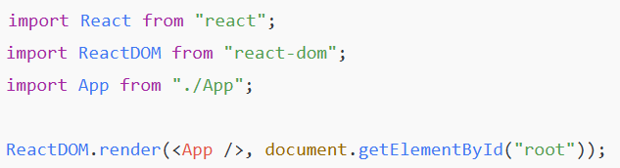
React Component (earlier before 17 version)
To display a component on the screen, React must render it into the DOM.
Parameter 1 → The element/component to render (<App />).
Parameter 2 → The target DOM node (document.getElementById("root")).

Slide 39

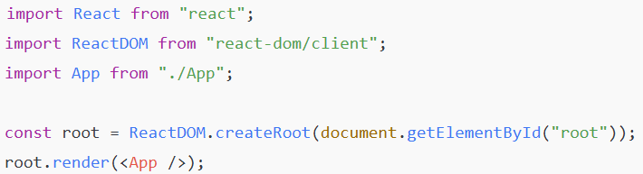
Rendering in React 18 (Modern, Recommended)
In React 18, ReactDOM.render is replaced by createRoot.
createRoot(...) → creates a React root for your app.
.render(...) → tells React which component to display inside that root.

Slide 40
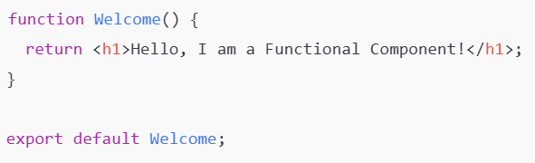
Functional Components (Modern Approach
Simple JavaScript functions that return JSX.
Can use Hooks (useState, useEffect, etc.).
Preferred way of writing components in modern React.

Slide 41
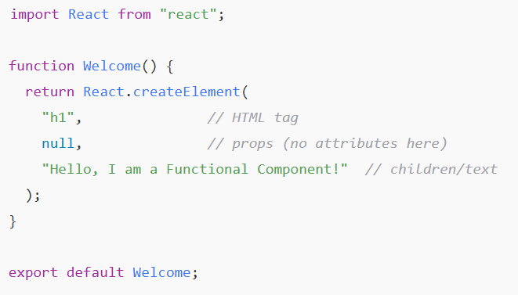
Equivalent JavaScript (Previous slide)

Slide 42
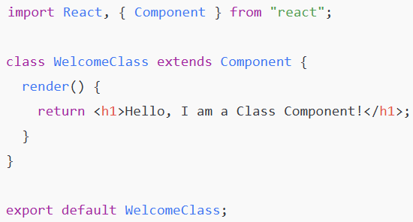
Class Components
Older way of writing components (before Hooks).
Use class, render() method, and this.state.
Still found in legacy codebases.

Slide 43
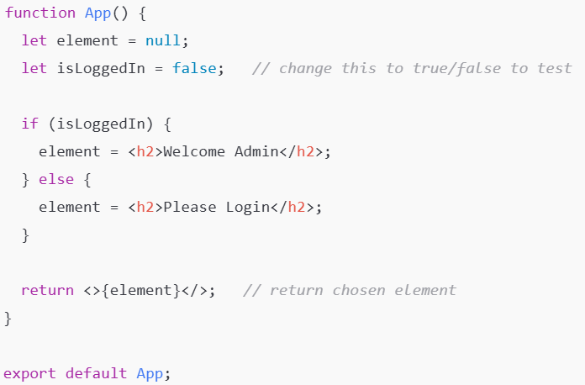
Render the content based on conditions
Using if-else

Slide 44
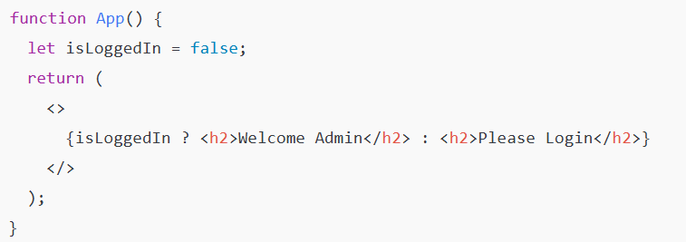
Render the content based on conditions
Inline Ternary Operator

Slide 45
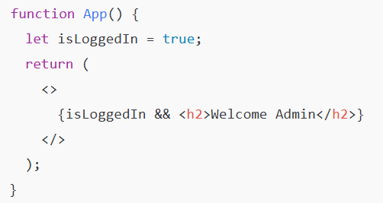
Render the content based on conditions
Logical AND (when only one condition matters)
If you only want to render something when true:

Slide 46
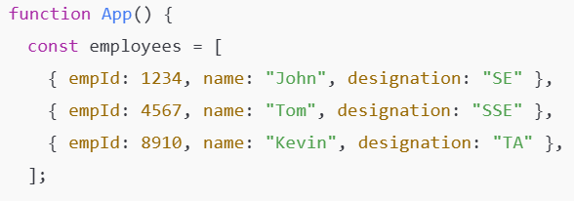
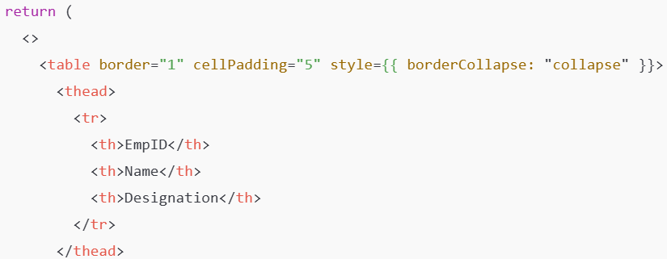
Render a list of employees inside a table
App.js

Slide 47
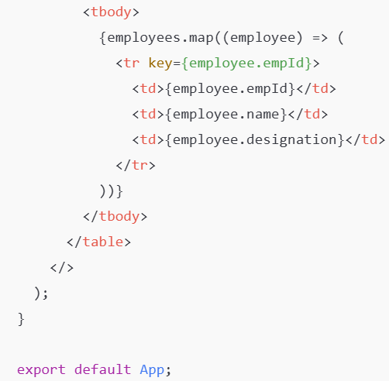
Render a list of employees inside a table (Contd..)

Slide 48
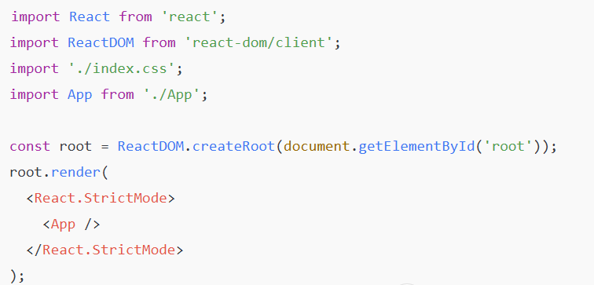
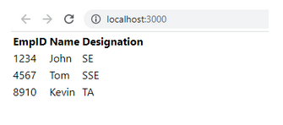
Render a list of employees inside a table
Index.js

Slide 49
React Lifecycle
Old: Class Component Lifecycle Methods
Every class component goes through 3 main stages:
Mounting → When component is created and inserted into DOM.
Updating → When component re-renders due to state/props changes.
Unmounting → When component is removed from DOM.🔹
Key Lifecycle Methods
componentDidMount() → Runs once after component is mounted (good for API calls, timers).
componentDidUpdate() → Runs after state/props update.
componentWillUnmount() → Runs before component is removed (cleanup).

Slide 50
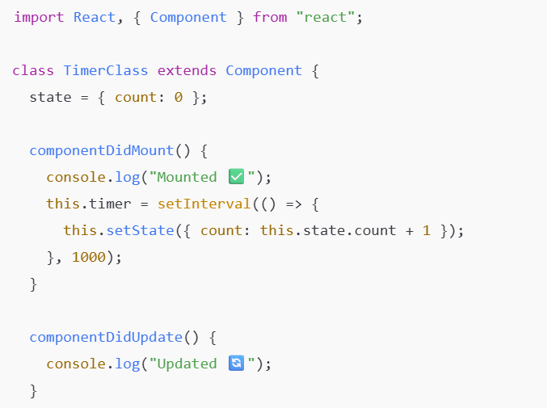
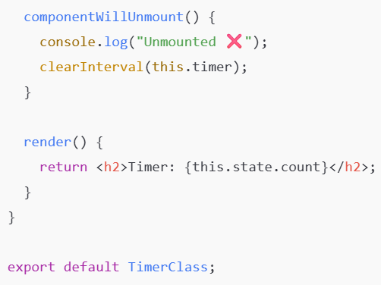
Class Component Lifecycle Methods (Example)

Slide 51
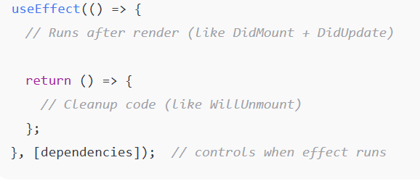
React Lifecycle
New: Functional Components with Hooks
Now we use useEffect hook instead of lifecycle methods.
useEffect combines componentDidMount, componentDidUpdate, and componentWillUnmount into one function.
Syntax

Slide 52
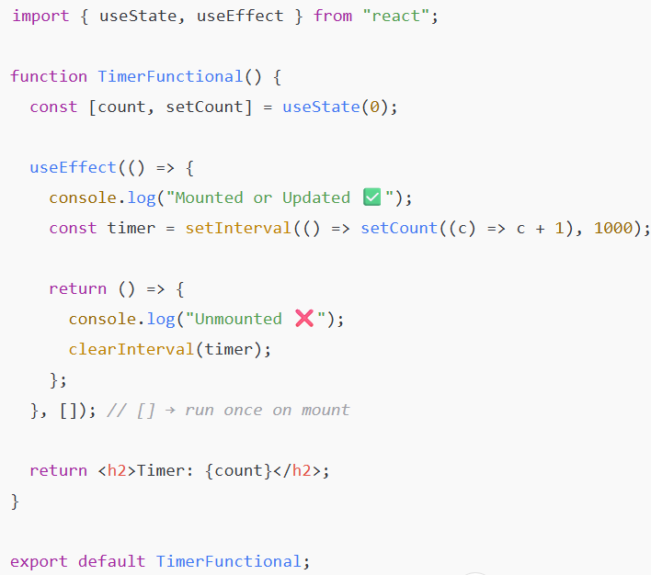
Example: (Same as class component) (Timer)

Slide 53
Comparison
Stage | Class Component Method | Functional Component (useEffect)
Mounting | componentDidMount() | useEffect(..., [])
Updating | componentDidUpdate() | useEffect(..., [state/props])
Unmounting | componentWillUnmount() | Cleanup inside useEffect

Slide 54
State
Definition: State is internal data managed by the component.
Source: Declared inside the component using useState (or this.state in class).
Mutability: Mutable — can be changed by setState (or setCount).
Purpose: To track data that can change over time (like user input, counters, toggle)

Slide 55
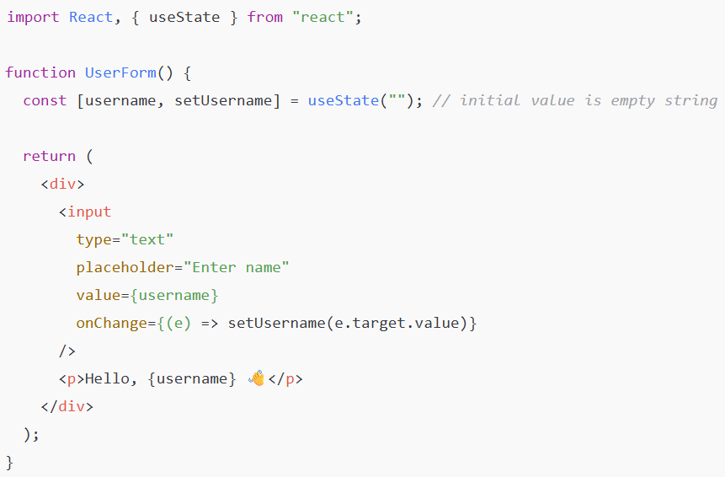
Real-World Examples (Functional Components)
Example 1: Username input

Slide 56
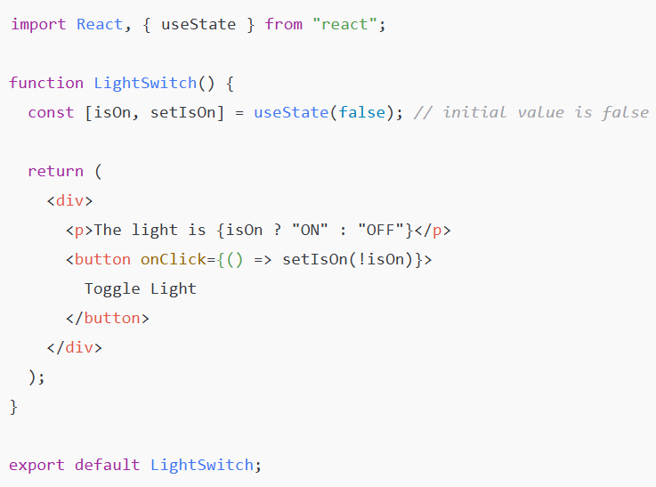
Example 2: Toggle Light ON/OFF

Slide 57
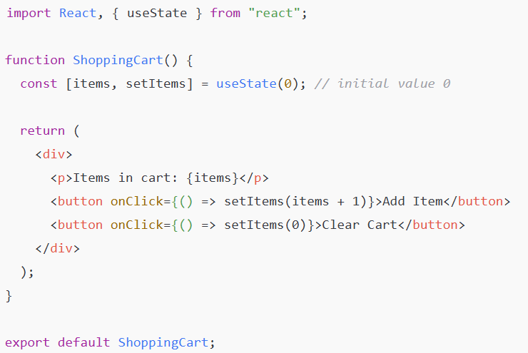
Example 3: Cart Items Count

Slide 58
Props
Props (short for “Properties”)
Definition: Props are inputs to a component.
Source: Passed from parent to child.
Mutability: Read-only inside the child.
Purpose: To make components reusable with different data.

Slide 59
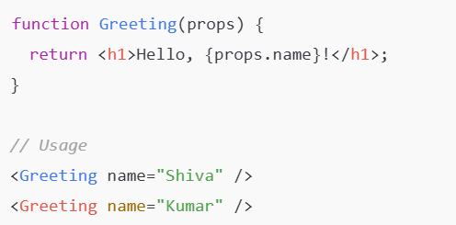
Example:

Slide 60
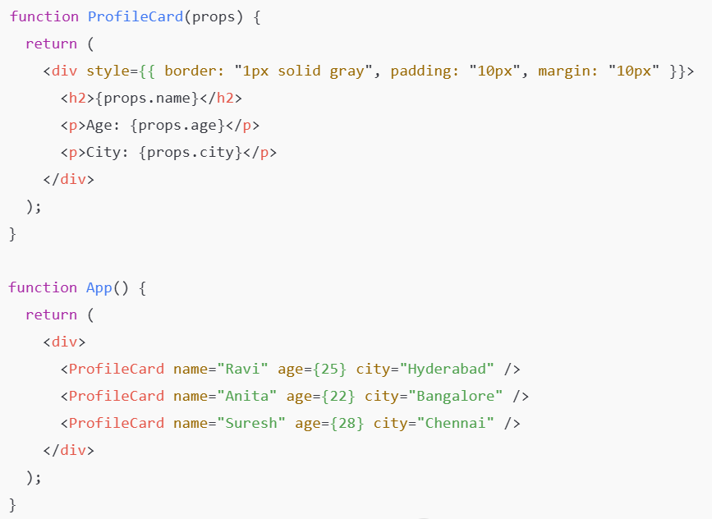
Profile Card (Example)
When building a profile card, you want to reuse the same component for different people

Slide 61
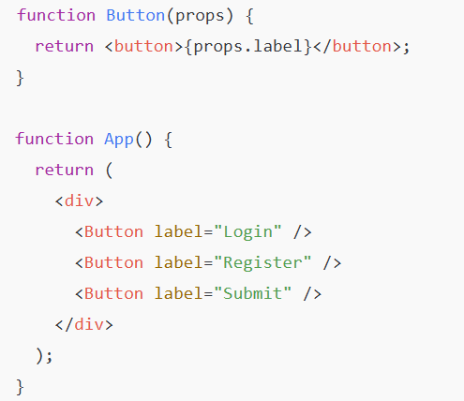
Button with Different Labels
One button component, used everywhere with different text.

Slide 62
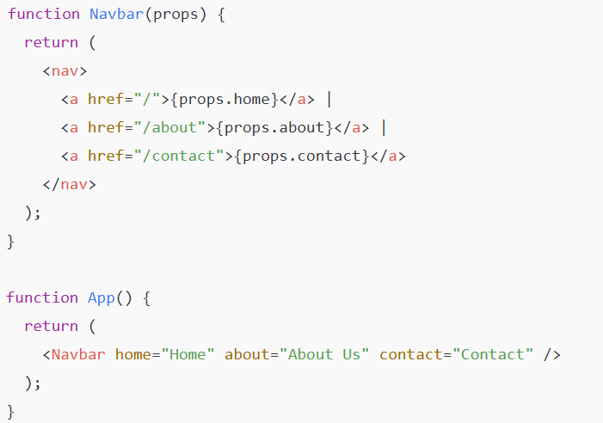
Navbar Menu
Pass menu items as props to a Navbar.

Slide 63
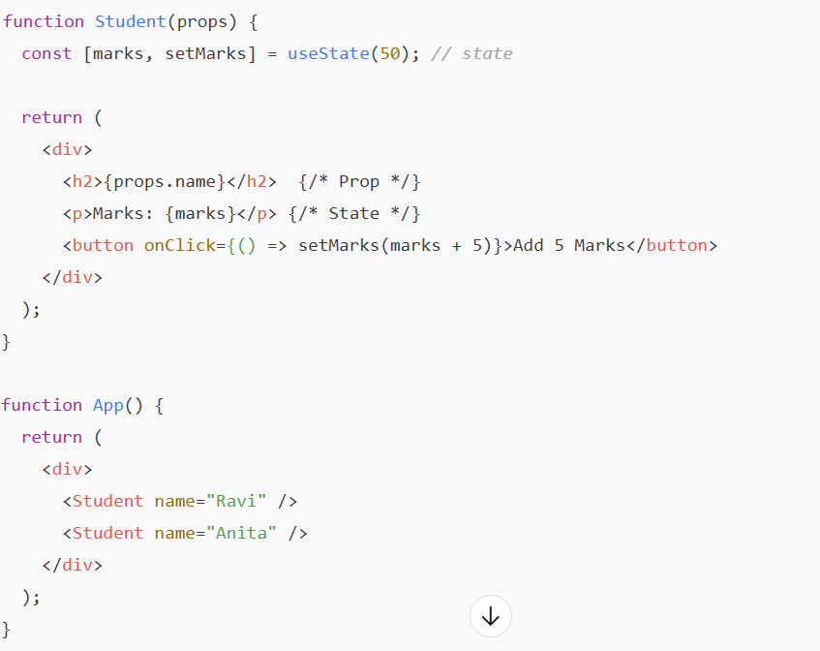
Combined Example: Props + State

Slide 64
Fragments in React
A Fragment is a special wrapper in React that lets you return multiple elements without adding an extra <div> in the DOM.
Normally, a React component can only return one root element.
Fragments solve this problem when you don’t want unnecessary wrappers.

Slide 65
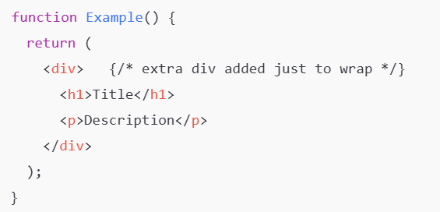
Example without Fragment
Problem: Adds an extra <div> in HTML which may break styling/layout.

Slide 66
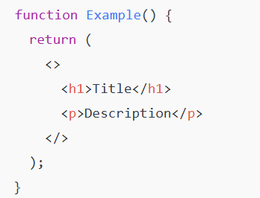
Example with Fragment
... </> is a Fragment (short syntax).
No extra <div> is added to the DOM.
Only <h1> and <p> will appear in HTML.

Slide 67
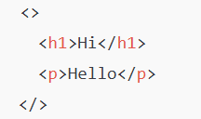
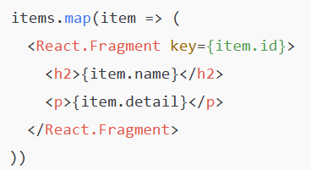
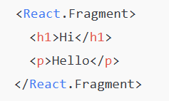
Ways to Write Fragments
Short syntax (most common)
Explicit syntax (can take key):
With key (useful in lists):

Slide 68
Why use Fragments
Avoid extra nodes in the DOM.
Cleaner and valid HTML (especially for lists, tables, layouts).
Improves performance (no unnecessary wrappers).
Fragments let you group multiple elements without adding extra DOM nodes.

Slide 69
Events in React
Events are actions triggered by the user or system.
Examples: clicking a button, typing in an input, submitting a form, mouse movement, key presses.
React events are very similar to DOM events, but with synthetic event system

Slide 70

Event Handling in React vs HTML
HTML Example:
React Example:
Differences:
React uses camelCase (onClick not onclick).
Pass a function (not a string).
We write React event handlers inside curly braces.

Slide 71
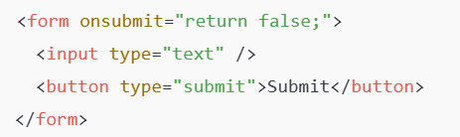
Preventing Default Behavior: React vs HTML/JS
In Native HTML/JavaScript
In plain JS, you can stop default behavior in two ways:
Calling event.preventDefault()
Returning false inside the handler (for some events like onsubmit, onclick)
Example (HTML + JS):
Here, returning false cancels the form’s default submission

Slide 72

Preventing Default Behavior: React vs HTML/JS
In React
You cannot return false to stop default behavior.
You must call event.preventDefault() explicitly.

Slide 73

Example: Button Click
Here, handleClick is an event handler function.

Slide 74

Passing Arguments to Event Handler

Slide 75
Common React Events
Event | Usage Example
onClick | Button click
onChange | Input field change
onSubmit | Form submission
onMouseEnter | Mouse hover
onMouseLeave | Mouse leave
onKeyDown | Key press down
onKeyUp | Key release
onFocus | Input focus
onBlur | Input blur (lost focus)

Slide 76


Slide 77
React Router
React Router is a library for handling routing in React applications.
It allows you to create single-page applications (SPAs) with multiple views (pages).
Instead of reloading the whole page, React Router switches components dynamically based on the URL.
Without Router: your React app is just one page.
With Router: you can have multiple pages like /home, /about, /contact — all without reloading

Slide 78
Why We Need React Router?
Multi-Page Application :
Every request will be sent to the server from the client.
The Server responds to the client with new HTML content.
Every time page reload will happen for every request.
This would increase the round trips to the server and cause delay in response.
In single page applications :
In MPA After the initial page load, no server communication is required for further page updates upon user interaction .
So here, we have to navigate from one view to another without hitting server.
For this React JS provides the react-router-dom library.

Slide 79


Installing React Router
Step 1 :
Step 2:

Slide 80

React Router
<BrowserRouter>:
The top-level router that wraps your app and enables routing using the browser’s HTML5 History API (pushState, replaceState).
Keeps the URL in sync with the UI without full page reloads. use:
Use basename prop if your app is served from a subfolder: <BrowserRouter basename="/my-app">

Slide 81

React Router
<Routes> and <Route> (v6)
In v6 you wrap all routes in <Routes> and each route uses <Route path="..." element={<Component/>} />.

Slide 82

Contd..
element expects a JSX element (<Home />), not the component identifier (Home) or a component prop (old API).

Slide 83

React Router
path
The URL pattern that this route should match (e.g. /, /about, /user/:id).
Dynamic segments use : (e.g. /user/:id) and can be read with useParams().
Link — navigation without reload:
<Link to="/about">About</Link>.
useNavigate() — programmatic navigation (replacement for useHistory):

Slide 84

Basic Setup (React Router v6+)

Slide 85

Contd..

Slide 86

Contd..

Slide 87
Key Concepts
Router Types
BrowserRouter → For modern browsers (most common).
HashRouter → Uses # in URLs (useful for legacy hosting).
Routes
Define which component should render for which URL path.
Link
Works like <a>, but doesn’t reload the page.

Slide 88

Key Concepts
useNavigate (Redirect)

Slide 89

Key Concepts
useParams (Dynamic Routes)

Slide 90

<Link> vs <NavLink> in React Router
<Link>
Used for basic navigation.
Changes the URL without reloading the page.
Does not provide any styling for active links.

Slide 91
<Link> vs <NavLink> in React Router
<NavLink>
Same as <Link>, but with extra styling features.
Automatically applies an active class (or custom styles) when the link matches the current route.
Useful for navigation menus where you want to highlight the active page.

Slide 92

Example (NavLink)

Slide 93
Use of Routes
Enables multi-page experience in SPAs
Avoids full page reloads → better performance
Allows dynamic routes (like /product/5)
Makes apps structured and scalable
React Router makes your single-page React app feel like a multi-page website, with smooth navigation and no reloads.

Slide 94
React Form
There are mainly two types of form input in React.
Uncontrolled component
Controlled component
In React, the form is usually implemented by using controlled components.

Slide 95
Uncontrolled component
Uncontrolled component: inputs keep their own internal state; React reads values via ref when needed.
The uncontrolled input is similar to the traditional HTML form inputs.
The DOM itself handles the form data.
Here, the HTML elements maintain their own state that will be updated when the input value changes.
Best for validation, instant UI feedback, keeping source-of-truth in React. Pros: simpler for small forms or file inputs, less re-rendering. Cons: harder realtime validation/feedback.

Slide 96

Uncontrolled component (example)

Slide 97

Contd..

Slide 98
Controlled Components
In React, Controlled Components are those in which form’s data is handled by the component’s state.
It takes its current value through props and makes changes through callbacks like onClick, onChange, etc.
Form inputs whose value is driven by React state (value + onChange).
Best for validation, instant UI feedback, keeping source-of-truth in React.
Pros: easy validation, predictable, works well with complex UIs. Cons: more boilerplate for large forms; frequent re-renders if misused.

Slide 99

Controlled Components (Example)

Slide 100

Contd..

Slide 101
Pagination in React
Pagination is the UI pattern that breaks a long list of items into pages so the user can view a subset at a time (e.g., 10 items per page) instead of loading or rendering everything all at once.
In React, pagination is implemented as a component (or set of components) that:
tracks the current page (state),
calculates which items to show for that page (client-side) or requests the correct page from a server (server-side),
provides controls (previous/next, page numbers, “load more”) to change pages,
and updates the UI when the page changes.
Pagination improves performance, UX, and network usage for large datasets.

Slide 102
Two common approaches
Client-side pagination
You already have all items in the client (e.g., an array).
The pagination component slices the array and shows only the current page items.
Good for moderately sized lists (hundreds — depending on memory).
Server-side pagination
The client requests a specific page (e.g., /api/items?page=3&pageSize=20) and the server returns just that page and metadata (total count).
Best for large datasets (thousands/millions) or when you want to reduce bandwidth.
React only stores the current page's items and requests new pages as the user navigates.

Slide 103
UX patterns & choices
Numbered pages (1,2,3,...) — clear for limited pages.
Previous / Next — simpler navigation.
“Load more” button — appends next page (good for mobile/feeds).
Infinite scroll — auto-loads more on scroll (requires careful accessibility + state handling).
Show totalPages, currentPage, and optionally totalItems.
Provide keyboard access and ARIA attributes for accessibility.

Slide 104

Example
For Programs of App.js and Pagination.js Click Here

Slide 105
React Tables
A table is an arrangement which organizes information into rows and columns. It is used to store and display data in a structured format.
Let us create a React app using the following command.
$ npx create-react-app myreactapp
$ npm install react-table-6
import ReactTable from "react-table-6";

Slide 106


React Tables

Slide 107

Contd..

Slide 108



Table Example dynamic loading (App.JS)

Slide 109

App.CSS

Slide 110

Results

Slide 111
Using React tables
react-table-6:
import ReactTable from "react-table";
import "react-table/react-table.css";
It is lightweight .
It is fully customizable
It has filters.
Minimal design & easily theme able

Slide 112
Common props & features in v6
data, columns — required.
defaultPageSize, pageSizeOptions — client-side paging.
sortable, filterable — enable sorting/filters (can be set globally or per-column).
className="-striped -highlight" — built-in CSS classes (if you imported the default CSS).
Server-side (manual) mode: pass manual and onFetchData plus pages:
manual tells the table you handle paging/sorting/filtering on the server.
onFetchData(state, instance) is called with parameters (page, pageSize, sorted, filtered) — use it to fetch data and then update data and pages.
loading — boolean to show a loading state.

Slide 113

After Using react-table
For code Click here (App.js & App.css)

Slide 114


App.js

Slide 115


Small server-side (manual) example sketch

Slide 116
React Hooks
Hooks were added to React in version 16.8.
Hooks allow function components to have access to state and other React features.
It allows you to use state and other React features without writing a class.
Because of this, class components are generally no longer needed.
Hooks allow us to "hook" into React features such as state and lifecycle methods.
Earlier, only class components could manage state. But with Hooks, function components can now also have state.

Slide 117
Rules of Hooks
Only call Hooks at the top level
Do not call Hooks inside loops, conditions, or nested functions. Hooks should always be used at the top level of the React functions.
Only call Hooks from React functions
You cannot call Hooks from regular JavaScript functions. Instead, you can call Hooks from React function components.

Slide 118
React Hooks (useState)
The useState hook allows us to create and manage state variables inside a function component.
The React useState Hook allows us to track state in a function component.
To use the useState Hook, we first need to import it into our component
import { useState } from "react";

Slide 119
Initialize useState
useState accepts an initial state and returns two values:
The current state. (stateVariable)
A function that updates the state. (setStateFunction)
const [stateVariable, setStateFunction] = useState(initialValue);
stateVariable: the current value of the state.
setStateFunction: function used to update that value.
initialValue: the starting value of the state.

Slide 120

Example of useState

Slide 121

Difference of using Class and useState Hook
counter implementation, Hooks version

Slide 122


Difference of using Class and useState Hook
counter implementation, Class version

Slide 123

Key differences (Using Class and Using Hooks)
1) Syntax & component type
Class component
Uses class, life-cycle methods like componentDidMount.

Slide 124

Key differences (Using Class and Using Hooks)
1) Syntax & component type
Function component (hooks)
Uses plain function and hooks (no lifecycle methods in same form).

Slide 125
Key differences (Using Class and Using Hooks)
2) State declaration
Class: state is a single object this.state = { ... }.
Hook: you can have multiple independent pieces of state:
const [a, setA] = useState(...).
3) Updating state
Class: this.setState({ count: this.state.count + 1 })
setState merges the provided object with current state.
Has an alternative functional form:
this.setState(prev => ({ count: prev.count + 1 }))
Hook: setCount(count + 1) or preferred functional form
setCount(prev => prev + 1).
Important: useState setter replaces the state value (not merge).
For objects you must copy previous state:
setObj(prev => ({ ...prev, newProp: value })).

Slide 126
Key differences (Using Class and Using Hooks)
4) this and binding
Class: methods rely on this. If you use class methods as callbacks you may need to bind them or use arrow syntax.
Hook: no this — simpler and avoids binding headaches.
5) Rules & usage
Class: lifecycle methods
(componentDidMount, componentDidUpdate, etc.).
Hook: use useEffect to handle side effects;
hooks have rules (only call at top level, only in React functions or custom hooks).

Slide 127
Key differences (Using Class and Using Hooks)
6) Readability & composition
Hooks encourage splitting logic into smaller hooks; easier to reuse logic.
Function components are now the preferred/modern style in React.7)
7) Behaviour on re-renders
Both cause re-render when state updates.
For safety when new value depends on old one, use functional updater form in both (prev => prev + 1).

Slide 128
React Hook: useEffect
In React, components can perform actions outside the normal rendering process, such as:
Fetching data from an API
Updating the browser title
Subscribing/unsubscribing to events
Running code only when something changes
These are called side effects.
The useEffect Hook lets you perform these side effects in function components — something that was previously only possible using lifecycle methods in class components (componentDidMount, componentDidUpdate, componentWillUnmount).

Slide 129

Syntax
Part | Meaning
useEffect | The Hook function
() => { ... } | Callback function containing the side effect
return () => { ... } | Optional cleanup function (runs before re-render/unmount)
[dependencies] | List of variables to watch for changes

Slide 130



Types of useEffect Calls
Run on Every Render
Run Only on Mount
Run When Dependencies Change

Slide 131

Types of useEffect Calls
Cleanup Function (Unmount or Before Next Effect)

Slide 132
Real-Life Analogy
Think of useEffect like after-sales service:
After you “render” a product (component),
You might need to perform some extra work (side effect),
And when the product is “returned” (unmounted), you clean up your service.

Slide 133

Example 1 — Simple useEffect (Runs after every render)
useEffect runs after each render (including the first render).
It updates the browser tab title each time the count changes.

Slide 134

Example 2 — Run Only Once (On Mount)
To run the effect only once (like componentDidMount in class),pass an empty dependency array [ ]
Explanation:
The empty dependency array ([]) tells React to run the effect only once, just like componentDidMount() in class components.
This is commonly used for:
Fetching data from
APIsSetting up event listeners
Initializing values when a component loads for the first time

Slide 135

Example 3 — Run When Dependencies Change
Explanation
The dependency array [name] tells React to run this effect only when the name value changes.
On the first render, it runs once.
Then, each time you click a button that changes the name, the effect runs again and logs the update.
This is very useful for:
Re-fetching data when a filter or input changes
Reacting to state updates (like form inputs or selections)

Slide 136


Example 4 — useEffect with Cleanup (Unmount or Before Next Effect)

Slide 137
Example 4 — useEffect with Cleanup (Unmount or Before Next Effect)
Explanation (Example of previous slide)
Here, we use setInterval to update a timer every second.
If we don’t clear it, it would continue running even after the component is removed — causing a memory leak.
That’s why we include a cleanup function that clears the interval.
The cleanup runs:
When the component unmounts
Or before running the next effect (if dependencies exist)

Slide 138
Summary Table — When Each Example Runs
Summary Table — When Each Example Runs of prious 4 example programs
Example | Dependency | When it Runs | Use Case
1️⃣ | None | After every render | Debug/logging, DOM updates
2️⃣ | [] | Only once on mount | Fetch data, initialization
3️⃣ | [value] | When that value changes | React to user input/state
4️⃣ | [] + Cleanup | On mount & unmount | Timers, event listeners

Slide 139
Difference Between useEffect and useState
Aspect | useState | useEffect
Purpose | Manage state (data) | Handle side effects
Runs | During rendering | After rendering
Example | const [count, setCount] = useState(0) | useEffect(() => { document.title = count; }, [count])

Slide 140
React useContext Hook
The useContext Hook allows you to access data from a Context in React without passing props manually through every level of the component tree.
It helps to avoid “prop drilling”, where props are passed through multiple nested components just to reach one component deep down.
Syntax:
const value = useContext(MyContext);
MyContext is the context object created using React.createContext().
value will be whatever value is provided by the nearest <MyContext.Provider> above in the component tree.

Slide 141
React useContext Hook
React Context is a way to manage state globally.
It can be used together with the useState Hook to share state between deeply nested components more easily than with useState alone.
Prop drilling :
Prop drilling refers to transporting this data/state as props to the intended destination through intermediate components.

Slide 142


React useContext Hook
Prop drilling

Slide 143
When to Use(useContext)
Use useContext when multiple components need access to the same data such as:
User authentication data
Theme (light/dark mode)
Language preferences
App-wide settings
Understanding the Flow
Create a Context
Provide a value to that context using <Context.Provider>
Consume the value using useContext(Context)

Slide 144
Examples (useContext)
Please access the all the examples of (useContext) in the following link

Slide 145
React Custom Hooks
Hooks are reusable functions.
When you have component logic that needs to be used by multiple components, we can extract that logic to a custom Hook.
A Custom Hook is a user-defined function in React that:
Starts with the word “use”
Uses one or more React built-in hooks (like useState, useEffect, etc.)
Helps to reuse stateful logic between multiple components
The main reason for which you should be using Custom hooks is to maintain the concept of DRY(Don’t Repeat Yourself) in your React apps.
Example: useFetchCBIT.
In simple terms:
When two or more components use the same logic, we can move that logic into a custom hook and reuse it.

Slide 146

Why Custom Hooks?
Problem | Solution
Repeating the same state logic in multiple components | Write a custom hook once, and reuse it
Making components long and complicated | Move side effects and logic out into custom hooks
Hard to maintain | Centralize logic for consistency
Syntax :

Slide 147

Example 1 — Custom Hook for Window Width
Let’s create a custom hook that tracks browser window width.
Step 1: Create the Hook
Continued example in next slide➔

Slide 148

Example 1 — Custom Hook for Window Width
Step 2: Use it in a Component
Continued example in next slide➔

Slide 149

Example 1 — Custom Hook for Window Width
Step 2: Use it in a Component
Explanation
The logic for tracking window resizing is inside the custom hook.
Any component can now simply import and use it without rewriting event listeners.
For more example programs Click here to access

Slide 150
Real-Life Analogy
Think of a Custom Hook like a reusable cooking recipe :
You write the recipe once (the hook).
Different chefs (components) can follow the same recipe anytime — saving time and ensuring consistency!

Slide 151
Rules for Custom Hooks
The name must start with “use” useTimer, useForm, useAuth, etc.
You can use other React hooks inside it (useState, useEffect, useContext, etc.)
You cannot call hooks conditionally or inside loops — follow the Rules of Hooks.

Slide 152
Summary of Custom Hook
Concept | Description
Custom Hook | A reusable function containing React hook logic
Syntax | function useSomething() { ... }
Reusability | Use across multiple components
Common Uses | Fetching data, local storage, timers, forms
Benefit | Cleaner, modular, and DRY (Don’t Repeat Yourself) code

Slide 153
Back End Integration in React
Back-end integration in React means connecting your frontend UI (built with React) to a server (backend) that provides: -
Data from a database –
Functionality like login, signup, fetching, adding, deleting, updating data –
Secure API endpoints
The frontend (React) communicates with the backend (Node.js + Express or any other server) through HTTP requests (GET, POST, PUT, DELETE).
For more access here with the link

Slide 154
React Portals
Portals provide a first-class way to render children into a DOM node that exists outside the DOM hierarchy of the parent component.
So far, we were having one DOM element in the HTML into which we were mounting our react application, i.e., the root element of our index.html in the public folder.
If you take a look at the browser in the DOM tree every single React component in our application falls under the root element, i.e., inside this statement.
<div id="root"></div>

Slide 155



React Portals
The React 16.0 version introduced React portals in September 2017.
ReactDOM.createPortal(child, container)
Index.html App.js Portaldemo.js

Slide 156

React Portals

Slide 157

React Portals
Index.html App.js Portaldemo.js

Slide 158

React Portals

Slide 159
React Portals
When to use?
Modals
Tooltips
Floating menus
Widgets
Event bubbling is a method of event propagation in the HTML DOM API when an event is in an element inside another element, and both elements have registered a handle to that event.
If we fire an event from inside a portal it will propagate to the Parent component in the containing React tree.

Slide 160
Axios in React
Axios is a promise-based HTTP client used to make requests (like GET, POST, PUT, DELETE) to:
REST APIs
External services
Backend servers (like Node.js, Express)
It’s similar to the built-in fetch(), but simpler and more powerful.

Slide 161
Installing Axios
Run this in your React project folder
npm install axios
Then import it in your component
import axios from 'axios';

Slide 162
Why Use Axios in React
It has good defaults to work with JSON data.
Axios has function names that match any HTTP methods.
Axios has better error handling.
Axios does more with less code.
Axios can be used on the server as well as the client.
Note : Complete Crud Operation Needs to be Written.

Slide 163

Using Axios — Example 1 (GET Request)
Let’s create a simple React component that fetches data from an API and displays it.
Example: Fetching user data from an API
1st Screen Shot

Slide 164


Using Axios — Example 1 (GET Request)
2nd Screen Shot
3rd Screen Shot

Slide 165


Using Axios — Example 2 (POST Request)
Now let’s send data to a server (e.g., submit a form).

Slide 166


Using Axios — Example 2 (POST Request)

Slide 167
Common HTTP Methods in Axios
Method | Description | Example
axios.get(url) | Fetch data | Get users
axios.post(url, data) | Send data | Create user
axios.put(url, data) | Update data | Update user
axios.delete(url) | Remove data | Delete user

